Slide 1



Continuity of Care: A Key Determinant of Mental Health and Quality of Life. Application to persons with (intellectual) disabilities and mental health problems.
Prof. Dr. Filip Morisse
Psicocap+
25/09/2025
Charleroi, UMons
Notes:
Ik dacht, ik moet een inleiding geven over de prijs Humane Psychiatrische Zorg, dit jaar over de dimensie TIJD, anders moet ik iets vertellen over Humane Psychiatrische Zorg en over tijd in de GGZ.
En zo zal het zijn …

Slide 2
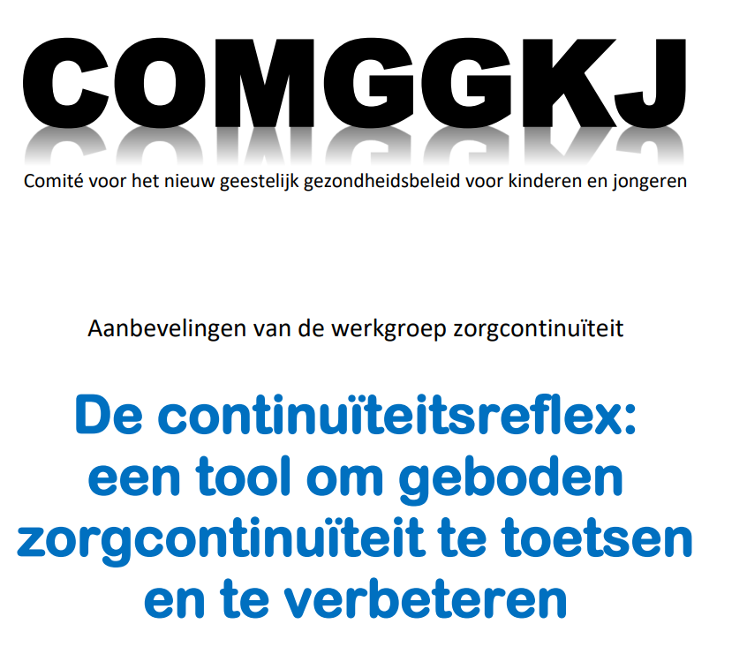


Slide 3

“From birth, always abrupt transitions, from one day to the next to a foster family, to a residential group, to another group… never any further contact with previous care providers.”
“I could not build friendships because I had to change groups so often.”
“At age 14, I was placed in a municipality I had never heard of; it was completely inaccessible by public transport.”
… barriers and ruptures …

Slide 4
Continuity of Care: conceptual
Layered concept
Relationship between continuity of care and quality of care
Continuity of care is about
interaction client – caregiver
coordination between different care systems; 'integrated'
gradual transitions
network perspective

Slide 5
Continuity of Care: Conceptual
Continuity of care should not be approached solely from the (professional) care perspective
Key factor: participation and sense of control over one’s own trajectory
Priority should be given to the perspective of (young) people themselves (and their environment)
Experienced continuity by young people: ‘disenchanting’ (Cachet, 2022)
Relevant domains:
Participation
Regionality
Accessibility
Collaboration
Notes:
Betrokken domeinen
Participatie
Regionaliteit
Toegankelijkheid
Samenwerking
Sleutelfactor: participatie en gevoel van controle over eigen traject
Beleefde continuïteit van jongeren zelf: ‘ontluisterend’

Slide 6
Continuity of care (COMGGKJ)
Both from scientific research, clinical practice, and from federal administration and Ministry, continuity of care appears to be one of the spearheads and indicators of current (quality of) care for, among others, children and young people in mental health care, especially for complex and comorbid target groups.
Continuity of care is divided into
relational continuity
management continuity
information continuity
experienced continuity (Freeman, 2007)
The latter, especially for children/young people themselves and their context, is considered to be the most guiding continuity.

Slide 7
‘Continuity-reflex’
 | Relational continuity | Management continuity | Information continuity | Experienced continuity
Participation
Accessibility
Collaboration
Others, e.g. legislation

Slide 8
“It helps if, as a young person, you can help prepare for the transition yourself.”
“After admission to the K-unit, there was a transition to independent living training; fortunately, someone I trusted accompanied me to the introductory meeting.”

Slide 9
 | Relational Continuity | Management Continuity | Informational Continuity | Experienced Continuity
Definition | 'Personal continuity’: a stable therapeutic relationship between a client and one or more care providers | Coordination and coherence of care; focus on flexible and seamless care within and across the boundaries of different care entities that are complementary and follow each other over time; as few partners as possible; flexible, responsive, contextual, and accessible | Using/sharing information from the past and the personal living circumstances of the client (including values and context) (so the patient doesn’t have to repeat their story everywhere) to tailor current care to the individual’s needs | 'When the patient/their family experiences their care as coordinated and smooth'; when the patient receives help when needed, and encounters the same people consistently

Slide 10
'Continuity-reflex'
Continuity of care is not primarily about referring (modules, intensities, escalations, stepped care etc.) but rather about 'holding on', also over time, in flexible ways. It's about valuing the existing fit ('what works'; 'where is there a click').
A transdiagnostic approach and intersectoral cooperation are standardly needed for continuity of care.
Creative co-productions for continuity of care require thinking outside the box (transcending classical lines and structures)

Slide 11
Application: persons with (intellectual) disabilities and mental health problems
15 à 50% (Munir, 2016; Mazza, 2020)
Characteristics
‘At risque’; client + environment
comorbidity
complexity
non-specificity
intensity
vulnerability

Slide 12
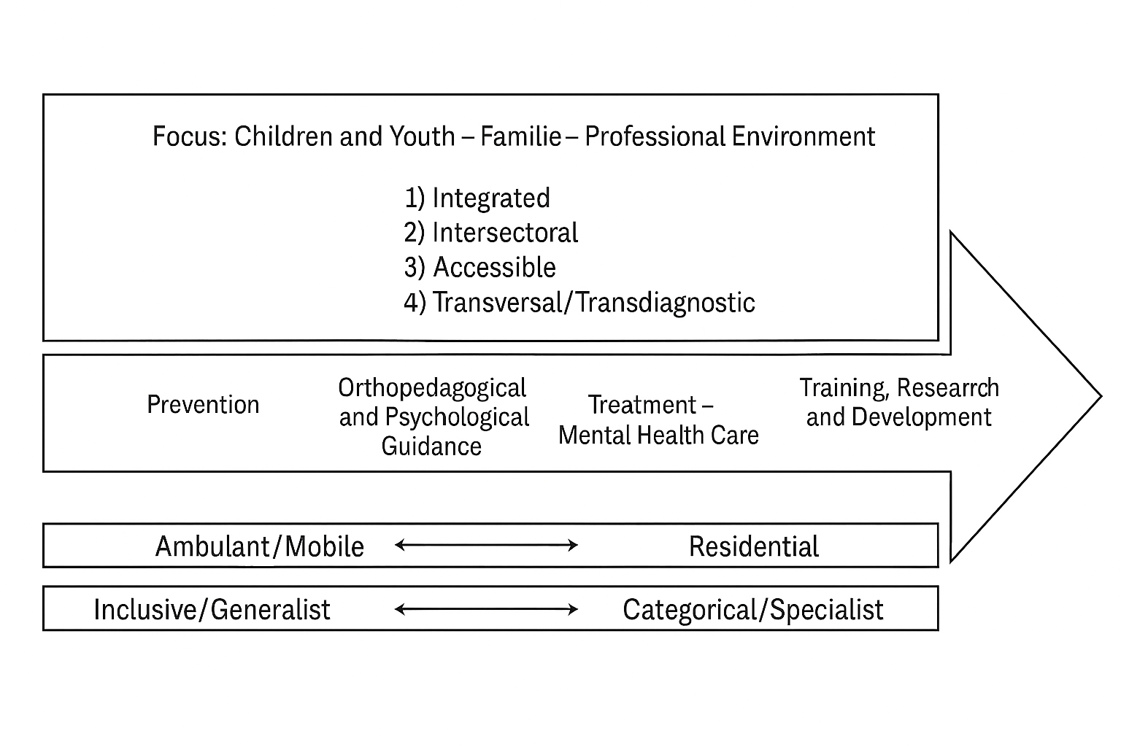

Slide 13
“I have had almost 80 caregivers but only trusted 2.”
“I could not build friendships because I had to change groups so often.”
“So difficult to keep meeting and trusting new people.”

Slide 14
Recommendations based on the literature (Rinaldi, 2025)
Intersectoral coordination and continuity: Regular collaboration between sectors (health, education, social, families), information sharing, case management, and co-constructed care pathways.
Integration of specialized care: Embedding expertise in existing structures, holistic approach, use of teleconsultation while avoiding a purely digital response.
Training and support for professionals: Continuous training, reflective attitude, ethical supervision, access to relevant resources, and recognition of the professional role.
Person-centered approach: Support for self-determination, valuing competencies, co-construction of care with the person, consideration of lived experience and subjective needs.

Slide 15
Recommendations based on the literature (Rinaldi, 2025)
Family involvement: Psychoeducational and emotional support, recognition of their expertise, access to information, combating isolation and stigma, development of respite solutions.
Reduction of structural and systemic barriers: Addressing fears of social judgment, delays in seeking help, effects of disclosure and medicalization, awareness of systemic discrimination.
Recognition of lived experience and experiential expertise: Peer participation, mentoring, sharing of meaningful information, egalitarian relationships, attention to hierarchical dynamics and subjectivity of trajectories.
Trauma-sensitive approach: Understanding emotional development and attachment, stress regulation, structured and safe environment, prevention of retraumatization, relational continuity.

Slide 16
Principles of mental health care to complexe populations
Transversal care continuum with smooth transitions
Subsidiarity
Inclusive where possible, categorical where necessary
Organize care in the living environment
Always work with the triad, in a system approach
Co-production
Adaptation of classical therapeutic methods + daily life
Time

Slide 17
Continuity of care: transversality
helps prevent ruptures/breaks in care trajectories
focuses on co-productions and intersectoral cooperation
strengthens the environment of children/young people, including with non-mental health partners
can work preventively regarding long admissions, readmissions, difficult reintegration into educational environments, and thus regarding further alienation
helps to arrive at shared care plans and actions
care transmission staff are flexibly, sometimes more present in the foreground, or in the background

Slide 18
“There should be more help at home. All parents raise their children in their own way. We should not tell them how to do it, but we should support them.”
“Caregivers judge too quickly based on what is in the file.”
“It is difficult to bring friends to the residential group, and there is too little free time to visit friends from previous placements.”“

Slide 19
Domain - Participation
 | Relational continuity | Management continuity | Information continuity | Experienced continuïteit
Participation | Transition participation – transition continuity Relational connectedness and the feeling of having a say and competence Shared decision making | Participation as a means to improve the care offering Patient council Confidentiality Accessibility - availability Children's rights and ethical aspects Making the care organization readable Cross-level connections between care levels | Child/young person as owner of their biographical and clinical information Seeking consensus on sharing information and what leads to certain decisions in the care pathway | Communicate in understandable language or non-verbally

Slide 20
Domain Accessibility
 | Relational continuity | Management continuity | Information continuity | Experienced continuity
Accessibility | Shared care Low-threshold access Case management | Expand accessibility of mental health care beyond office/school hours and through various modalities (e.g., online) Improve existing networks General intake teams Coordination with general (somatic) care In mental health care, avoid stagnation or delays in other domains such as education, independent living, and employment | Shared client information Fast and smooth network consultations (with or without the client and their context present) Focus on creating tailored shared care plans to optimize access to other services, increasing continuity of care | Location-based; within one’s own, highly diverse living environment Smaller gap between “inside and outside” Focus on the young person’s own strengths within their broad context (already present in their own living world)

Slide 21
Domain - Collaboration
 | Relational continuity | Management continuity | Information continuity | Experienced continuity
Samen-werking | Voorzien ook zorg en ondersteuning op praktische en sociale domeinen. Trajectbegeleiding, zorgregisseur of case-management Innovatieve zorgvormen als BOR (bed op recept) Recht op discontinuïteit | Gedeelde beeldvorming en behandeldoelen. Werken met noden i.p.v. labels en diagnoses Co-producties, co-creaties, co-financiering | Transdisciplinaire en intersectorale samenwerking. Uitwisseling expertise, vorming, intervisie en wisselleren. | Verbied niet alle nabijheid en contacten tussen medebewoners maar begeleid op maat de meerwaarde en de mogelijke risico’s van deze contacten. Advocacy-functie Extra aandacht voor transitie-leeftijd

Slide 22
Back to application to persons with intellectual disabilities and mental health problems: reflections regarding generic vs. specialist
People with intellectual disabilities and mental health problems are not a different kind of people and therefore have no fundamentally different needs
A good starting point is therefore that they are welcome in generalist mental health services
If additional expertise is needed, it can be added outreach/mobile teams.
In some cases, it may be better to provide care in specialized services, but these also have disadvantages (concentration of externalizing behavior).
Plea for diversity and heterogeneity.

Slide 23
Care for persons with ID en MH problems
There seems to be a great eagerness in generalist services to refer to specialized services as quickly as possible.
Instead of either generalist or specialist, everything indicates that both are needed and that cooperation is the only option.
Guidance in pairs, co-productions yield much better results than referrals.

Slide 24
Environment Makes the Difference. What Kind of Caregivers Do Clients with Intellectual Disabilities and Mental Health Problems Need?
Attention and presence
Sensitive and responsive
Constantly reflecting/mentalizing about client, self and relationship
Flexibly adapting and attuning
Balance distance-closeness; islands of contact; space and availability vs. boundaries
Sturdiness, and strong in 'helpful boundaries'

Slide 25
Environment Makes the Difference. What Kind of Caregivers Do Clients with Intellectual Disabilities and Mental Health Problems Need?
Expert in co-regulating
Balance rest-action
'Normal' and small things
To love and to let love
... top athletes
... magicians

Slide 26


